Slide 1
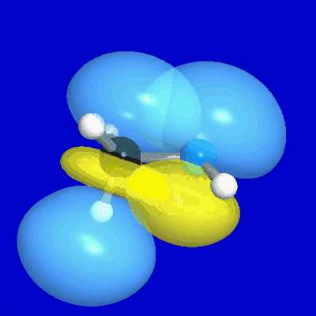
Natural Bond Orbital
NBO 5.0 and NBOView* http://www.chem.wisc.edu/~nbo5/
Most graphics created with NBOView using NBO 5.0 output
*Program and Manual (c) Copyright 1996-2004 Board of Regents of the University of Wisconsin System on behalf of the Theoretical Chemistry Institute. All Rights Reserved.

Slide 2
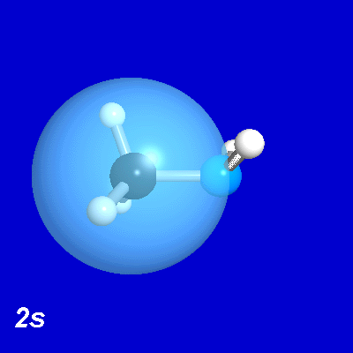
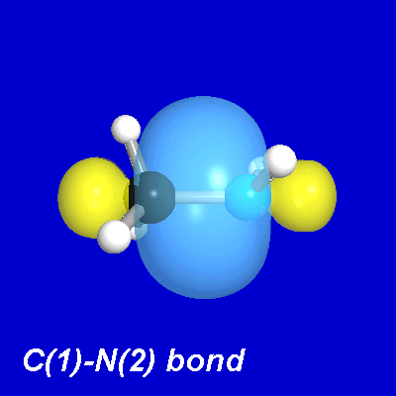
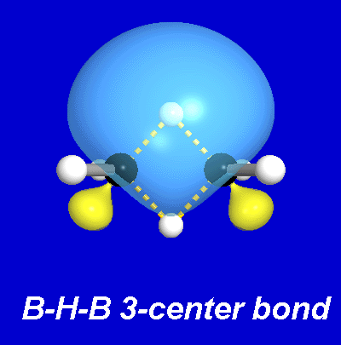
What Do You Want From A Computation?
Quantitative Accuracy
Firm Mathematical Foundations
General Predictions of Chemical Reactivity
Intuitive Interpretations of Spectroscopic Data
Teachable Explanations for General Audiences
Illustrative Graphics
Maximizing Computational Insights: The NBO Vision!

Slide 3
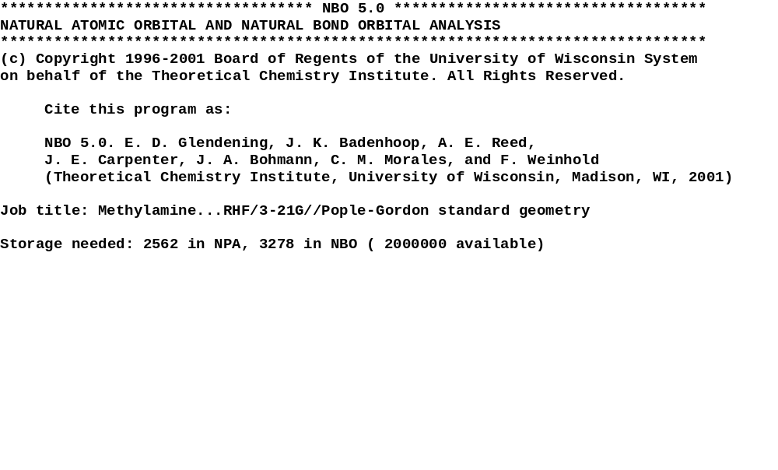
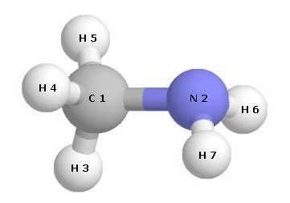
NBO Translates Accurate Calculations Into Chemical Insights
Charges
Lewis Diagrams
Bond Types
Hybrid Descriptors
Bond Orders
Charge Transfer
NMR Descriptors
Resonance Weights
And more…

Slide 4
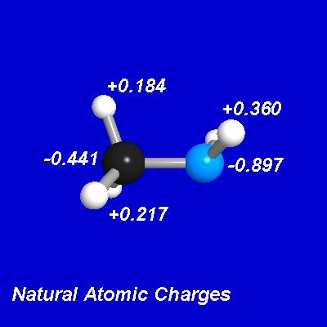
NBO Translates Accurate Calculations Into Chemical Insights
Charges
Lewis Diagrams
Bond Types
Hybrid Descriptors
Bond Orders
Charge Transfer
NMR Descriptors
Resonance Weights
And more…
Summary of Natural Population Analysis: Natural Population
Natural -------------------------------------------------
Atom # Charge Core Valence Rydberg Total
-----------------------------------------------------------------------
C 1 -0.44079 1.99900 4.43848 0.00331 6.44079
N 2 -0.89715 1.99953 5.89378 0.00384 7.89715
H 3 0.18370 0.00000 0.81453 0.00177 0.81630
H 4 0.21713 0.00000 0.78192 0.00096 0.78287
H 5 0.21713 0.00000 0.78192 0.00096 0.78287
H 6 0.35999 0.00000 0.63879 0.00122 0.64001
H 7 0.35999 0.00000 0.63879 0.0012 0.64001
=======================================================================
* Total * 0.00000 3.99853 13.98820 0.01328 18.00000
****Sample Output****

Slide 5
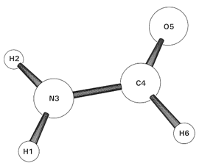
NBO Translates Accurate Calculations Into Chemical Insights
Charges
Lewis Diagrams
Bond Types
Hybrid Descriptors
Bond Orders
Charge Transfer
NMR Descriptors
Resonance Weights
And more…
NATURAL BOND ORBITALS (Summary):
Principal Delocalizations
NBO Occupancy Energy (geminal,vicinal,remote)
=======================================================================
Molecular unit 1 (CH3NO)
1. BD ( 1) H 1- N 3 1.99309 -0.89250 32(v),20(v)
2. BD ( 1) H 2- N 3 1.99322 -0.87920 3(v),19(v),32(v),21(v)
3. BD ( 1) N 3- C 4 1.99828 -1.10527 29(g),28(g)
4. BD ( 1) C 4- O 5 1.99925 -0.50592 31(g),16(v)
5. BD ( 2) C 4- O 5 1.99802 -1.40674 19(g),28(v)
6. BD ( 1) C 4- H 6 1.98929 -0.75792 29(v),23(v),15(v)
7. CR ( 1) N 3 1.99922 -15.31924 20(v),19(v),13(v),14(v)
8. CR ( 1) C 4 1.99939 -11.16963 27(v),29(v),28(v)
9. CR ( 1) O 5 1.99963 -20.09206 19(v),25(g),20(v)
10. LP ( 1) N 3 1.80683 -0.39458 31(v),22(v
11. LP ( 1) O 5 1.98262 -0.93620 19(v),20(v),33(v),30(v)
29(r)
12. LP ( 2) O 5 1.88568 -0.40982 30(v),33(v),20(v)
****Sample Output****

Slide 6
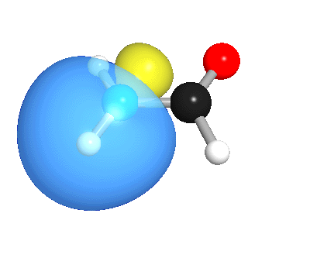
NBO Translates Accurate Calculations Into Chemical Insights
Charges
Lewis Diagrams
Bond Types
Hybrid Descriptors
Bond Orders
Charge Transfer
NMR Descriptors
Resonance Weights
And more…
(Occupancy) Bond orbital/ Coefficients/ Hybrids
-------------------------------------------------------------
1. (1.99309) BD ( 1) H 1- N 3
( 29.05%) 0.5390* H 1 s(100.00%)
-1.0000 -0.0010
( 70.95%) 0.8423* N 3 s( 30.92%)p 2.23( 69.08%)
0.0002 -0.5561 -0.0020 0.6879 0.0155
-0.4660 0.0088 -0.0001 0.0000
2. (1.99322) BD ( 1) H 2- N 3
( 28.52%) 0.5341* H 2 s(100.00%)
-1.0000 -0.0043
( 71.48%) 0.8454* N 3 s( 30.20%)p 2.31( 69.80%)
0.0001 -0.5495 -0.0009 0.1158 0.0158
0.8273 0.0052 0.0000 0.0000
****Sample Output****
1. H1-N3
•NBO Type
N-H sigma bond
•Hybrid Composition
0.5390(s)_{H} + 0.8423(sp^{2.23})_{N}
•Occupancy
1.99309 e

Slide 7
NBO Translates Accurate Calculations Into Chemical Insights
Charges
Lewis Diagrams
Bond Types
Hybrid Descriptors
Bond Orders
Charge Transfer
NMR Descriptors
Resonance Weights
And more…
(Occupancy) Bond orbital/ Coefficients/ Hybrids
-------------------------------------------------------------
1. (1.99309) BD ( 1) H 1- N 3
( 29.05%) 0.5390* H 1 s(100.00%)
-1.0000 -0.0010
( 70.95%) 0.8423* N 3 s( 30.92%)p 2.23( 69.08%)
0.0002 -0.5561 -0.0020 0.6879 0.0155
-0.4660 0.0088 -0.0001 0.0000
2. (1.99322) BD ( 1) H 2- N 3
( 28.52%) 0.5341* H 2 s(100.00%)
-1.0000 -0.0043
( 71.48%) 0.8454* N 3 s( 30.20%)p 2.31( 69.80%)
0.0001 -0.5495 -0.0009 0.1158 0.0158
0.8273 0.0052 0.0000 0.0000
****Sample Output****
1. H1-N3
•NBO Type
N-H sigma bond
•Hybrid Composition
0.5390(s)_{H} + 0.8423(sp^{2.23})_{N}
•Occupancy
1.99309 e

Slide 8
NBO Translates Accurate Calculations Into Chemical Insights
Charges
Lewis Diagrams
Bond Types
Hybrid Descriptors
Bond Orders
Charge Transfer
NMR Descriptors
Resonance Weights
And more…
Natural Bond Order: (total/covalent/ionic)
Atom 1 2 3 4 5 6
---- ------ ------ ------ ------ ------ ------
1. H t 0.0020 0.0000 0.9959 0.0000 0.0000 0.0000
c --- 0.0000 0.5787 0.0000 0.0000 0.0000
i --- 0.0000 0.4172 0.0000 0.0000 0.0000
2. H t 0.0000 0.0050 0.9928 0.0000 0.0000 0.0000
c 0.0000 --- 0.5664 0.0000 0.0000 0.0000
i 0.0000 --- 0.4265 0.0000 0.0000 0.0000
3. N t 0.9959 0.9928 0.7691 1.2422 0.0000 0.0000
c 0.5787 0.5664 --- 0.7519 0.0000 0.0000
i 0.4172 0.4265 --- 0.4903 0.0000 0.0000
4. C t 0.0000 0.0000 1.2422 0.0000 1.7904 0.9674
c 0.0000 0.0000 0.7519 --- 1.0967 0.7956
i 0.0000 0.0000 0.4903 --- 0.6937 0.1719
5. O t 0.0000 0.0000 0.0000 1.7904 2.2076 0.0000
c 0.0000 0.0000 0.0000 1.0967 --- 0.0000
i 0.0000 0.0000 0.0000 0.6937 --- 0.0000
6. H t 0.0000 0.0000 0.0000 0.9674 0.0000 0.0275
c 0.0000 0.0000 0.0000 0.7956 0.0000 ---
i 0.0000 0.0000 0.0000 0.1719 0.0000 ---
****Sample Output****
1.79
1.24
H1-N3: 0.58 Covalent + 0.42 Ionic = 1.00 Total
N3-C4: 0.75 Covalent + 0.49 Ionic = 1.24 Total
C4-O5: 1.10 Covalent + 0.69 Ionic = 1.79 Total
1.00

Slide 9
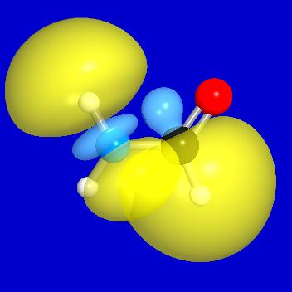
NBO Translates Accurate Calculations Into Chemical Insights
Charges
Lewis Diagrams
Bond Types
Hybrid Descriptors
Bond Orders
Charge Transfer
NMR Descriptors
Resonance Weights
And more…
SECOND ORDER PERTURBATION THEORY ANALYSIS OF FOCK MATRIX IN NBO BASIS
Threshold for printing: 0.50 kcal/mol
E(2) E(j)-E(i) F(i,j)
Donor NBO (i) Acceptor NBO (j) kcal/mol a.u. a.u.
==========================================================================
within unit 1
1. BD ( 1) H 1- N 3 20. RY*( 2) C 4 2.54 1.89 0.062
1. BD ( 1) H 1- N 3 32. BD*( 2) C 4- O 5 4.41 1.74 0.078
2. BD ( 1) H 2- N 3 19. RY*( 1) C 4 2.10 1.76 0.054
2. BD ( 1) H 2- N 3 21. RY*( 3) C 4 0.59 2.32 0.033
2. BD ( 1) H 2- N 3 32. BD*( 2) C 4- O 5 1.28 1.72 0.042
2. BD ( 1) H 2- N 3 33. BD*( 1) C 4- H 6 2.45 1.53 0.055
3. BD ( 1) N 3- C 4 28. BD*( 1) H 1- N 3 0.64 1.76 0.030
3. BD ( 1) N 3- C 4 29. BD*( 1) H 2- N 3 0.71 1.76 0.032
4. BD ( 1) C 4- O 5 16. RY*( 2) N 3 0.89 1.90 0.037
4. BD ( 1) C 4- O 5 31. BD*( 1) C 4- O 5 0.95 0.67 0.024
5. BD ( 2) C 4- O 5 19. RY*( 1) C 4 1.83 2.29 0.058
5. BD ( 2) C 4- O 5 28. BD*( 1) H 1- N 3 1.59 2.06 0.051
6. BD ( 1) C 4- H 6 15. RY*( 1) N 3 0.65 2.81 0.038
6. BD ( 1) C 4- H 6 23. RY*( 1) O 5 1.61 2.79 0.060
6. BD ( 1) C 4- H 6 29. BD*( 1) H 2- N 3 5.24 1.42 0.077
****Sample Output****
σ(C4-H6)→σ*(H2-N3) stabilization
5.24 kcal/mol (2nd order estimate)

Slide 10
NBO Translates Accurate Calculations Into Chemical Insights
Charges
Lewis Diagrams
Bond Types
Hybrid Descriptors
Bond Orders
Charge Transfer
NMR Descriptors
Resonance Weights
And more…
Natural NMR Chemical Shielding Tensor Analysis
NCS Tensor analysis is using 8624 words
Threshold for printing: 0.10 ppm
Summary of isotropic NMR chemical shielding
Total Lewis (L) and non-Lewis (NL) contributions: (ppm)
NBO C( 1) N( 2) H( 3) H( 4) H( 5) H( 6) H( 7)
------------ ------- ------- ------- ------- ------- ------- -------
1. C 1- N 2 L -6.54 6.39 0.56 0.50 0.50 2.41 2.41
NL 0.17 -0.35 0.03 0.08 0.08 -0.09 -0.09
2. C 1- H 3 L -4.21 0.50 26.52 1.85 1.85 0.10 0.10
NL -0.61 -0.39 0.07 -0.05 -0.05 -0.01 -0.01
3. C 1- H 4 L -2.64 2.11 2.10 25.73 2.04 0.13 0.21
NL -0.21 -1.42 -0.01 0.05 0.04 -0.04 -0.08
4. C 1- H 5 L -2.64 2.11 2.10 2.04 25.73 0.21 0.13
NL -0.21 -1.42 -0.01 0.04 0.05 -0.08 -0.04
5. N 2- H 6 L 0.09 7.19 0.34 0.29 0.24 22.87 3.36
NL -0.01 0.17 -0.02 -0.12 -0.01 0.03 -0.04
****Sample Output****
The σ(C1-N2) bond de-shields the carbon by 6.54ppm and shields the nitrogen by 6.39ppm.

Slide 11
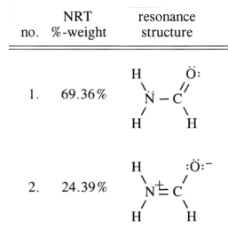
NBO Translates Accurate Calculations Into Chemical Insights
Charges
Lewis Diagrams
Bond Types
Hybrid Descriptors
Bond Orders
Charge Transfer
NMR Descriptors
Resonance Weights
And more…
Resonance
RS Weight(%) Added(Removed)
-------------------------------------------------------------------------
1*(2) 69.36
2* 24.39 N 3- C 4, ( C 4- O 5), ( N 3), O 5
3 2.37 ( N 3- C 4), C 4- O 5, N 3, ( O 5)
4 (2) 1.99 C 4- O 5, ( C 4- H 6), ( O 5), H 6
5 (2) 0.76 N 3- C 4, ( C 4- H 6), ( N 3), H 6
6 0.36 ( H 2- N 3), N 3- C 4, ( C 4- H 6), H 2
7 0.16 ( H 1- N 3), N 3- C 4, ( C 4- O 5), O 5
8 0.15 ( H 2- N 3), N 3- C 4, ( C 4- O 5), O 5
9 0.14 ( H 1- N 3), N 3- C 4, ( C 4- O 5), H 1
10 0.14 ( H 2- N 3), N 3- C 4, N 3- C 4, ( C 4- O 5),
( C 4- H 6), H 2, ( N 3), O 5
11-15 0.17
-------------------------------------------------------------------------
100.00 * Total * [* = reference structure]
****Sample Output****
To get the 2nd resonance structure from the 1st:
Add a bond between N3 and C4
Remove a bond between C4 and O5
Remove a lone pair on N3 and add a lone pair to O5

Slide 12
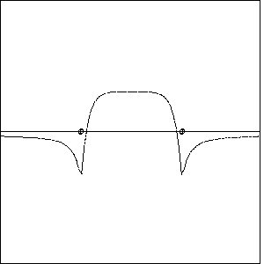
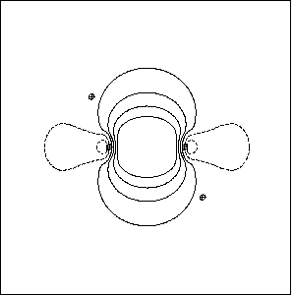
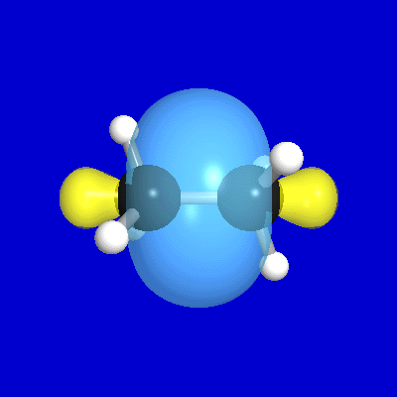
NBO Builds Enduring Bridges: Communicating Quantum Chemistry to Non-Specialists
Simple, Intuitive Building-Block Approach
Preserves Quantitative Accuracy
Connects with College Chemistry Concepts
Informative Graphical Representations with NBOView
Ethane C-C σ bond in 1, 2, and 3 dimensions

Slide 13
New Features in NBO 5.0
Canonical Molecular Orbital (CMO) Analysis
Natural Chemical Shielding (NCS) Analysis
Natural J-Coupling (NJC) Analysis
3-center, 4-e Hyperbond (3CHB) Search
Larger Systems
Natural Resonance Theory (NRT) Improvements
Natural Localized Molecular Orbital (NLMO) Improvements
STERIC Improvement
New Checkpointing Options
New Matrix Output Options
Transition Metal Hybrid Directionality
Basis Linear Dependency Detection/Protection
New PC-Windows GENNBO Stand-Alone Version

Slide 14
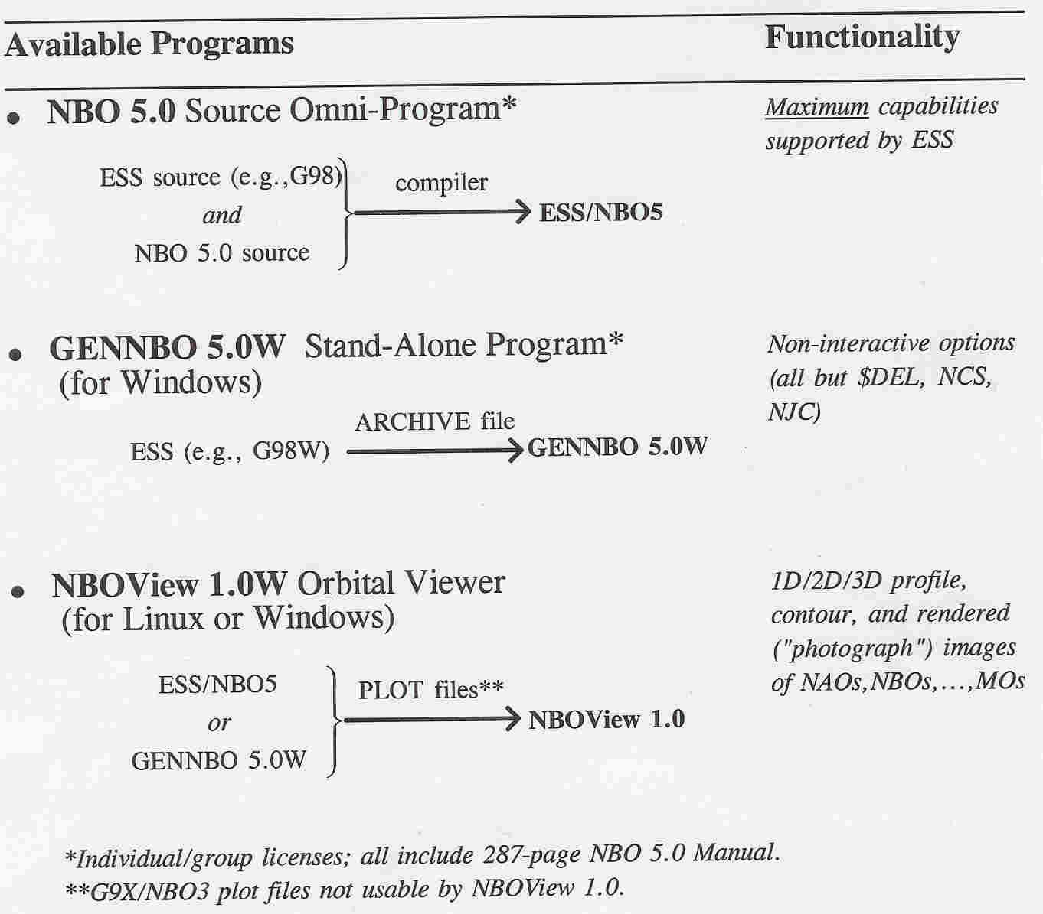
NBO Programs and Interfaces for Host Electronic Structure Systems (ESS)
Linked or Unlinked GAUSSIAN/NBO5 Interfaces for Every Need

Slide 15
Ordering Information
Beijing Hongcam Software Technologies Ltd.
hong@hongcam.com.cn
sales@hongcam.com.cn
Tel: (86)-10-82608964
Fax: (86)-10-82608954
Cell: 13801223223
ChangYuan TianDi,Room 1102,Bldg.4,A1
No.18 Suzhou Street BEIJING HAI DIAN 100080
PEOPLE'S REPUBLIC OF CHINA
http://www.chem.wisc.edu/~nbo5/

